Slide 1


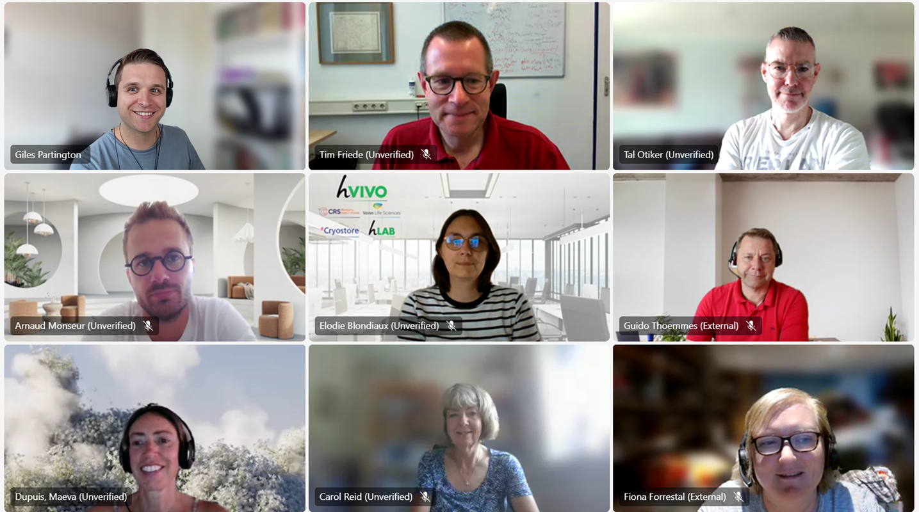



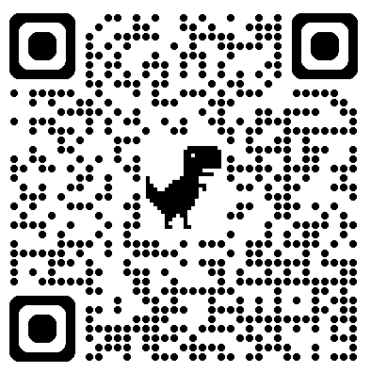
The PSI/EFSPI Small Population
Special Interest Group
Giles Partington, Maeva Dupuis, Aysun Cetinyurek-Yavuz on behalf of the Small Population SIG
Who are we?
Previous meeting Presentations
A group of 17 statisticians across industry, academia and multiple countries led by our co-chairs Tal Otiker (GSK) & Aysun Cetinyurek-Yavuz (Radboud UMC).
We meet online on the last Friday of the month for a 90-minute meeting looking at updated EMA approvals of small population trials and presenting new methods or interesting work that we have been involved in to facilitate discussions and learning around the topic.
We also work alongside other Special Interest Groups to put on Webinars for the wider PSI community.
In 2024, we hosted a webinar in collaboration with the RWD SIG called Harnessing Real-World Data (RWD) in clinical trials for small populations and rare diseases.
This year we have also taken on multiple collaborative pieces of work including:
Comparisons of dynamic borrowing methods.
Consolidation of guidelines within the field of rare disease.
Clarification of terminology around types of external controls.
Each of these topics plan to have outputs for publication, conferences and on our website.
Examples of presentations from our monthly meetings include:
Registrational Phase 2 study in patients with systemic lupus erythematosus
Use of a waiting natural history study followed by an interventional study to decrease heterogeneity, in a Gene-therapy phase 1/2/3 in DMD
Introduction to Causal Inference
Estimating the right estimand: a joint model for estimating mean change from baseline with multiple intercurrent events, including via composite strategy
Quantitative Decision-Making in Ulcerative Colitis Utilizing Historical Placebo Data
Experiences using RWE in rare disease/small population trials
Employing a latent variable framework to improve efficiency in composite endpoint analysis
Bayesian designs for augmenting control arms with external data in RCT
Challenging my ideas from the past – a problem from a rare disease study
Testimonials from Members
"In our group, we share real examples – from recent drug approvals in rare disease to innovative trial designs for small populations. This exchange of ideas helps us design better studies and propose more suitable analyses tailored to the specific challenges of small populations." - Elodie Blondiaux, Venn Life
"Connecting with others who share interest in rare disease/small population trials means I can share my experiences whilst learning from others to forward my understanding and be more prepared for future client work." - Giles Partington, Phastar
If you want to get involved: contact our co-chairs, check out our website, or speak to some of our members in attendance:
Maeva Dupuis, Aysun Cetinyurek-Yavuz and Tim Friede
"I feel welcome and appreciated in the Small Populations SIG group, where the low threshold to get involved has made it easy to collaborate and engage meaningfully at an appropriate level." - Maya Marintcheva-Petrova, Danone
Guidelines
External Controls
The field of rare disease trials is a wide and far- reaching one with many difficulties surrounding more standard techniques.
Thankfully, many guidelines have been published to help support researchers and trialists in producing effective trials.
As part of the PSI Special Interest Group for small population trials, we felt it would be helpful to create a repository of all available guidelines and a summary of overlap to give a clear guidance on what people should be aware of when trying to design small population trials or trials in rare diseases. There will be separate focus on trials in paediatric populations and early phase trials.
Look out for the summary and repository on our website coming later this year.
One methodology to overcome small sample sizes encountered with small population and rare disease trials that is gaining more traction over time is utilizing outside sources of information as a control, whether this be through real world data, simulation, or historic trial data.
As this is a relatively new technique, there have been many different names and terminologies thrown around for quite similar ideas.
We at the PSI Small Populations Special Interest Group felt it would be helpful to collate all currently used terms within external controls, along with definitions of what they are and how they are used.
Look out for our definitions list on our website coming later this year.
https://www.psiweb.org/sigs-special-interest-groups/small-populations

